Slide 1
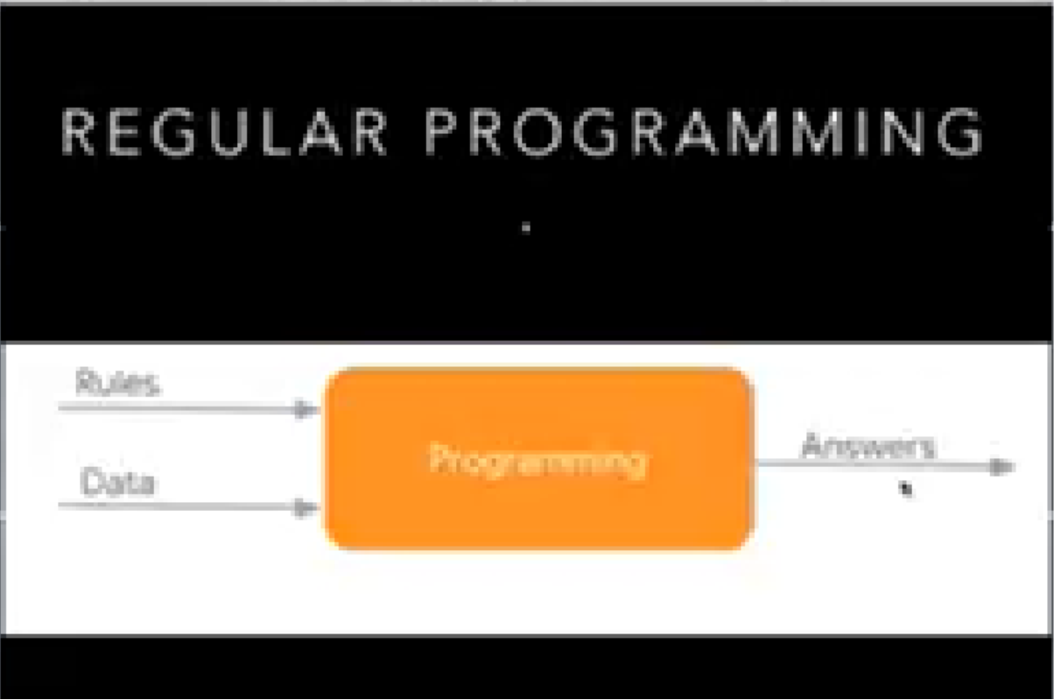

Slide 4
ML-Machine Learning

Slide 6
Types of Learning

Slide 7
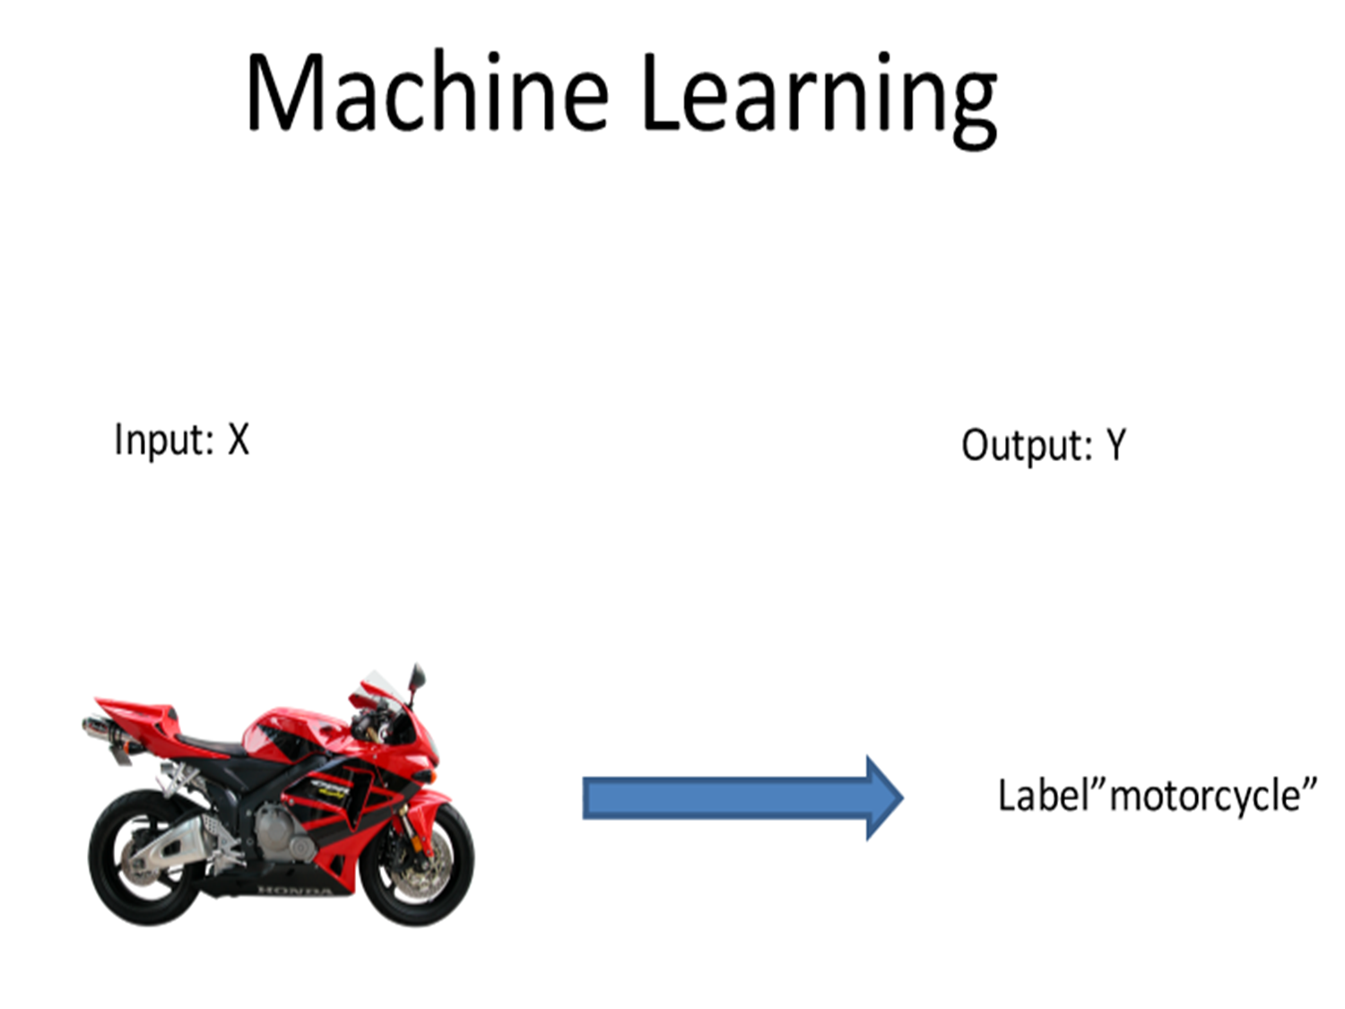

Slide 8
Classification

Slide 17
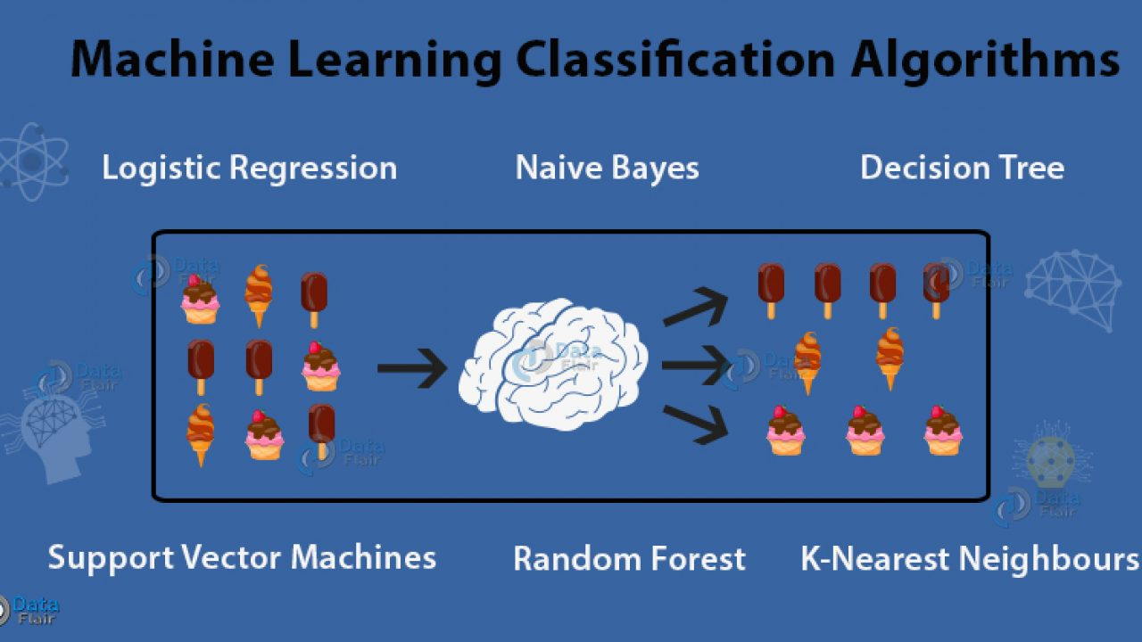

Slide 20
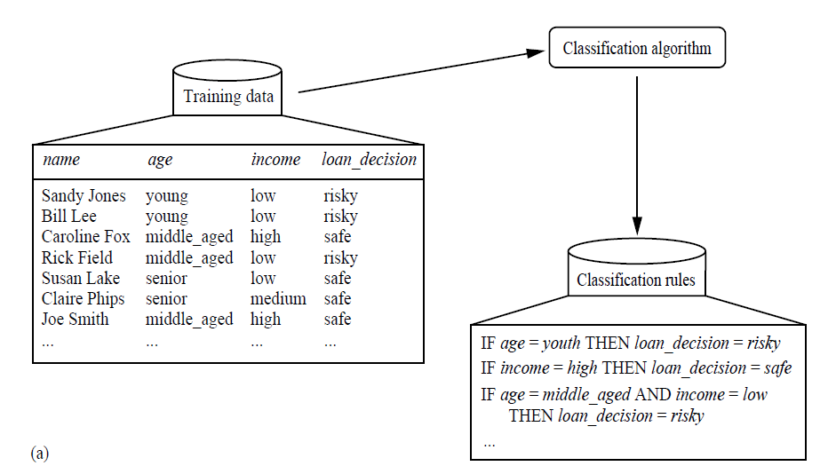
Classification

Slide 21
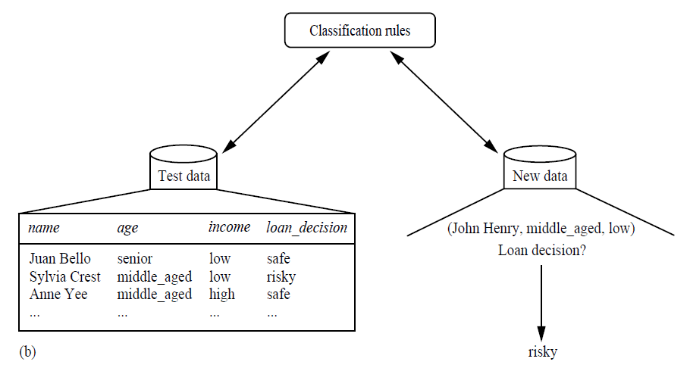
Classification- Testing

Slide 22
Illustrating Classification Task

Slide 23
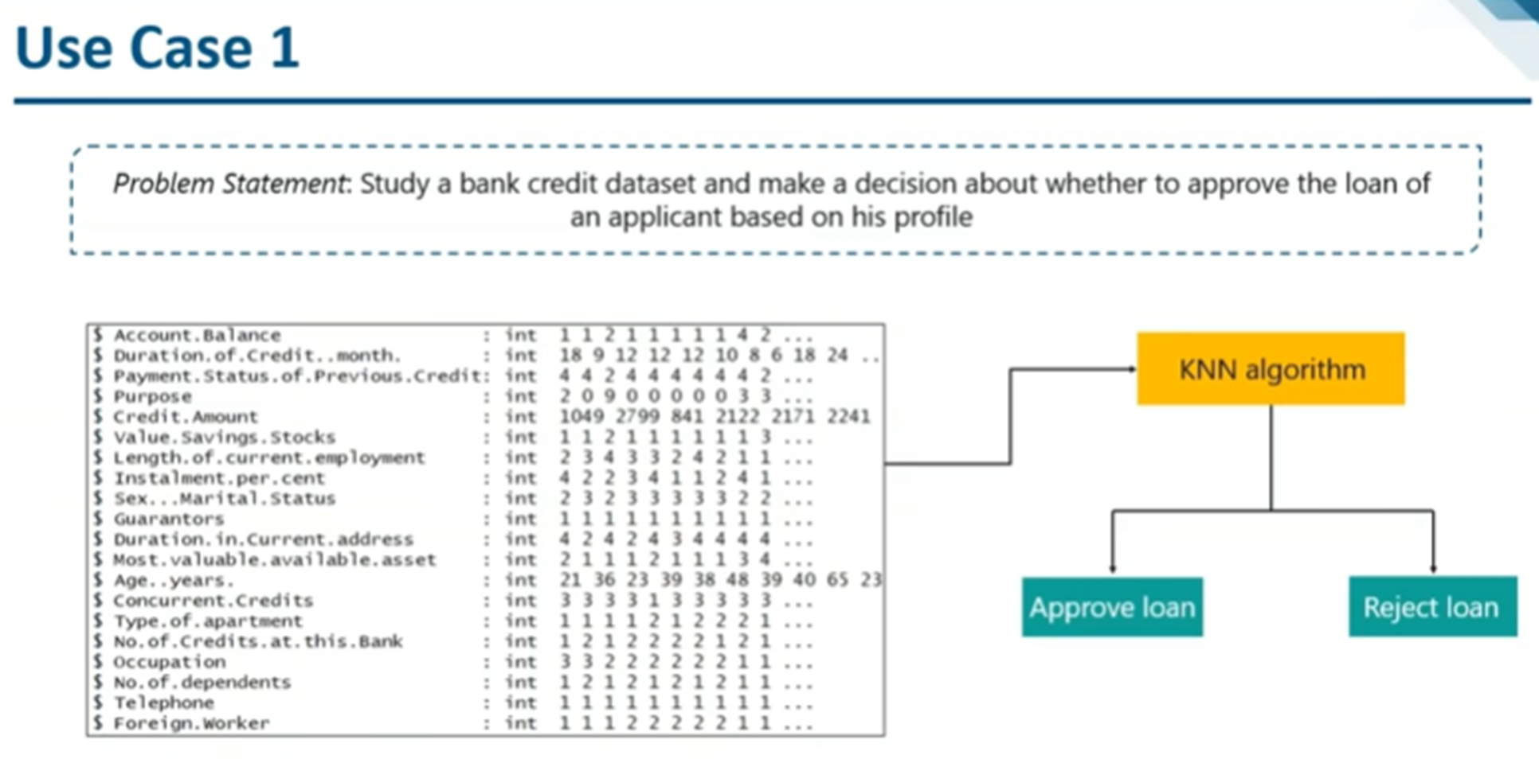
Classification

Slide 24
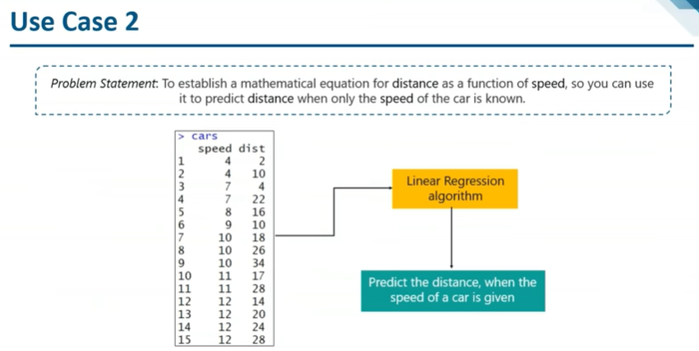
Classification

Slide 25
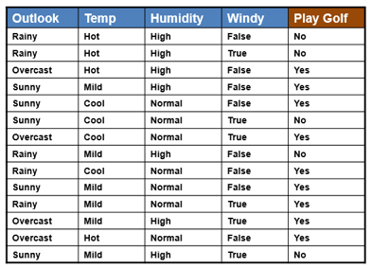
Classification

Slide 26
Classification

Slide 27
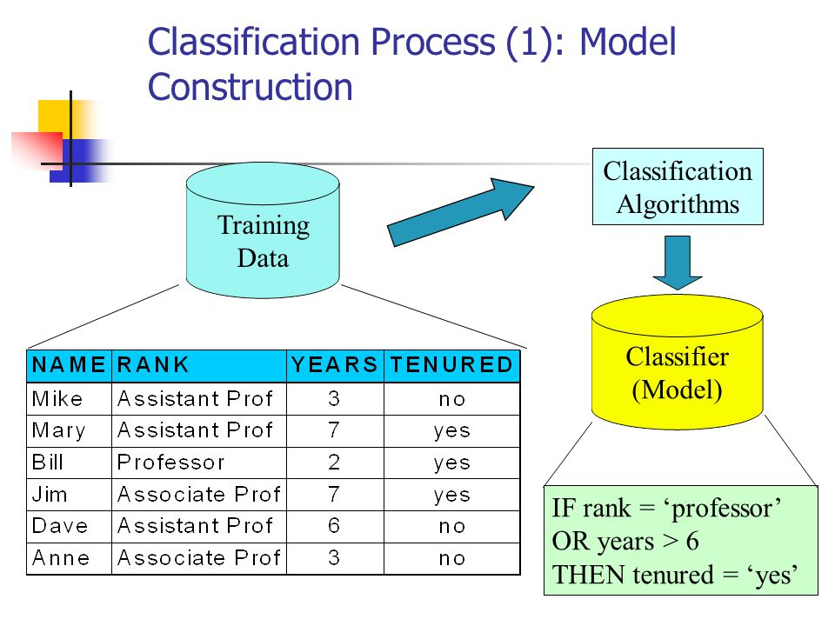

Slide 28
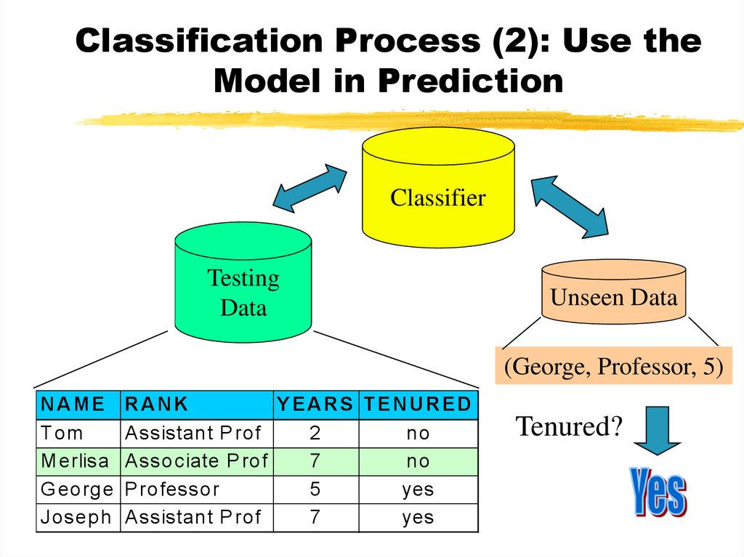

Slide 30
Evaluation of classification models
Counts of test records that are correctly (or incorrectly) predicted by the classification model
Confusion matrix
Predicted Class
 | Class = 1 | Class = 0
Class = 1 | f₁₁ | f₁₀
Class = 0 | f₀₁ | f₀₀
Actual Class

Slide 31
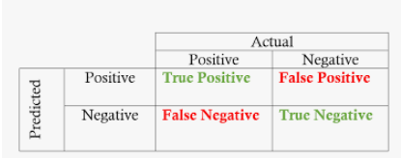
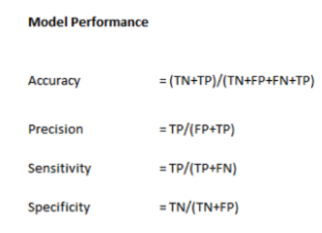

Slide 32
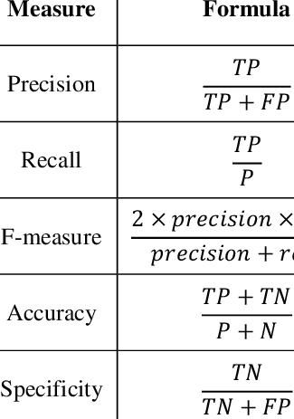

Slide 33
Classification

